Slide 1
Weekly Status Call
May 16, 2019

Slide 2
Agenda/General Session
Poll – What Topics Do You Want?
Temporary Cost Transfer Policy
Upcoming System Upgrades
Asset Management – Known Issue
Purchase Order Close
Position Funding Cube Workshop
New Version of Budget Status Report Now Available
Short Work Breaks
Termination Reminders
UGAJobs Training Resources
Georgia Statewide Background
Investigations – Update
2019 W-2s in OneUSG Connect
Entering Consent for Electronic W-2
Faculty Contract Delivery Timeline
Office of Faculty Affairs Open Office Hours
Compensatory (Comp) Payout FY2019
Faculty Access Extension
May 2019 Calendar View
June 2019 Calendar View

Slide 3
May 16, 2019
Session Highlights/Updates

Slide 4
Don’t Forget! Upcoming System Upgrades
Financial Management System will be upgrading
Friday, May 17, 2019 (5 p.m.) – Monday, May 20, 2019 (7:00 a.m.)
Budget Management System will be upgrading
Friday, May 31, 2019 (7 p.m.) – Saturday, June 1, 2019
OneUSG Connect
Friday, June 7 (5 p.m.) – Tuesday, June 11, 2019 (7 a.m.)
Friday, June 21 (5 p.m.) – Monday, June 24, 2019 (7 a.m.)
OneUSG Connect Benefits (for benefits enrollment) will remain active!

Slide 5
Temporary Cost Share Cost Transfer Policy
While we await the final cost share set-up guidelines, many users have been accounting for cost share using state funded chartstrings that have not yet been assigned to a sponsored project. In order to reduce the burden of transferring these cost share transactions, between now and July 1, 2019, please attach the following statement as a pdf in place of the cost transfer form. This is a temporary statement to be used on cost share cost transfers that meet these circumstances.
I attest that this transfer of charges is part of the initial cost share set up and not an error. No charges from one sponsored project to another are involved in this transfer. This transfer only involves moving charges from one nonsponsored project fund source to cost share for a sponsored project. I understand that this procedure will be in effect until 07/01/2019. After this date all transfers are subject to cost transfer policy.
More information on this policy can be found on the Sponsored Projects Administration website.

Slide 6
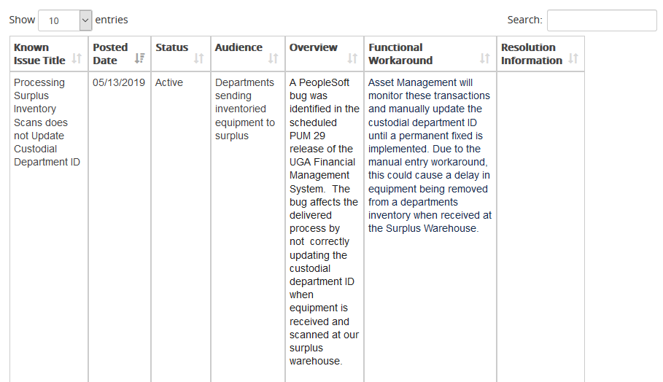
Asset Management Known Issue

Slide 7
Purchase Order Close
Purchase Order Close: All open Purchase Orders (PO) with remaining encumbrances should be reviewed and any funds that will not be needed should be unencumbered.
This is achieved by departments/units following specific instructions/procedures that have been shared with the members of the Business Services Advisory Group (BSAG) as well as with the UGAmart approver email listserv.
Within this procedure, queries have been provided to enable users to view POs with a remaining encumbrance. The procedure outlines the departmental action that can be taken.
The preferred method is for users to run query UGA_PO_CLOSE for their department(s), export to an excel spreadsheet, and indicate the requested action in the “Action CLOSE or Remain OPEN” column. The navigation for Query Viewer is: Main Menu > Reporting Tools > Query > Query Viewer. This spreadsheet can then be sent to the email address identified in the procedure, POClose@uga.edu.
NOTE: The query mentioned above does not display subaward POs or POs with non-expense chartstring distributions. Please review the procedure for details on these types of POs.
The procedures can be found on the UGAmart homepage or by following this link: https://busfin.uga.edu/procurement/pdf/PO_Closing_Year_End_Procedures.pdf

Slide 8
Reporting Workshop Position Funding Cube
The Position Funding Cube provides payroll expense details and encumbrance amounts by chartstring by employee.
Position Funding Cube Workshop
Tuesday, May 28, 2019
10 a.m. to noon
Georgia Center, Mahler Hall
No registration necessary
Available online through Collaborate
http://datawarehouse.uga.edu/
You will click the link to join the session on May 28, 2019. No advance registration is required to join to participate online.
Notes:
Crystal will discuss. Holly will include the link if it is ready by Thursday or by website posting

Slide 9
New Version of Budget Status Report Now Available
https://datawarehouse.uga.edu/reports/

Slide 10
New Version of Budget Status Report Now Available
Used to manage budget, not transaction line detail
Modeled after the PSR tableau version
3 views: dept by fund, fund by dept, class by dept
Can subscribe people to views

Slide 11
May 16, 2019
OneUSG Connect Module Awareness

Slide 12
Short Work Breaks What You’ll See for Summer Academics
Effective Date | Short Work Break | Return from Work Break | Notes
6/1/19 | SWB |  | Puts them on SWB (Short Work Break) for their normal position. Prevents encumbrance for June.
6/1/19 |  | RWB - $0 comp | Activates payroll, normal salary is not paid
Summer Academic Payroll processed |  |  | May, June, July Additional Pay processed by Payroll
8/1/19 | SWB |  | Puts the “summer” status on SWB
8/1/19 |  | RWB – New salary with merit or old salary | Adds their new salary or returns their regular salary
Add Content
Notes:
Mike Gorman will discuss

Slide 13
Workforce Administration Termination Reminders
When processing termination of employee requests, please include in the comments section:
•Department/Position Information
•Last day worked
•If the person is on leave/applicable dates
•If you are aware of a transfer
Workforce Administration (WFA) will determine the effective dates based on the information the department has provided.

Slide 14
UGAJobs Training Resources
User Guides (position management, postings & hiring proposals, etc.):
https://hr.uga.edu/supervisors/employment-administration/post-a-uga-staff-position/
Recorded Training Sessions & Tutorials in the Training Library under OneUSG Connect Topics > UGAJobs
By appointment (please reach out to hrweb@uga.edu to schedule)
Unit
Individuals
Available for questions at weekly OneSource Office Hours on Thursdays 3:00-5:00 p.m. at Caldwell Hall, room 410.

Slide 15
Georgia Statewide Background Investigations Update
Human Resources is aware of Sterling background processing delays due to these new requirements and is actively seeking solutions to help alleviate delays.
Exploring options with new background vendor, Accurate.
On April 15th, Georgia Bureau of Investigations (GBI) Georgia Criminal Information Center (GCIC) changed their consent form requirements where the (GBI/GCIC) now requires an additional consent form in order for Sterling (Background investigation vendor) to process a State of Georgia Statewide criminal background check through the Georgia State Criminal Repository.
If an applicant is required to complete the GCIC consent form, Human Resources will reach out to them directly. They will receive a separate email notification from employ@uga.edu with the consent form and instructions attached.
Applicants requiring a GCIC background check will receive two emails as follows:
one from Sterling Talent Solutions (DoNotReply@talentwise.com) which includes a link for the applicant to access and complete the remaining information through Sterling’s secure portal, and
one from UGA Human Resource (employ@uga.edu) pertaining to their Georgia Statewide paper consent form

Slide 16
Payroll 2019 W-2s in OneUSG Connect
Additional communication as we approach November 2019 and are closer to the 2019 tax season.
You must enter your consent for electronic delivery through the OneUSG Connect Employee Self-Service site. Your consent for your electronic 2018 W-2 with the UGA legacy self-service site was not converted to OneUSG Connect.
You will be able to enter your consent after you receive your first paycheck with the new system.
When W-2s are available, you will be able to access your W-2 through the OneUSG Connect ESS site.
If you do not choose electronic delivery, your W-2 will be mailed to you.
If you leave UGA (termination or retirement), you will NOT be able to access your W-2 through the ESS site, if you consented to receive electronic delivery. Before leaving UGA, be sure to go into OneUSG Connect Self-Service and remove your consent for electronic W-2. If not, you will have to contact OneUSG Connect Support to have your W-2 mailed to you.

Slide 17
Payroll Entering Consent for Electronic W-2
Entering your consent for electronic W-2 in OneUSG Connect:
Go to the OneUSG Home page and click on Employee Self-Service at top of screen
Click on the Taxes tile
Click on W-2/W-2c Consent
The W-2/W-2c Consent Form page will show current status of No consent received or Consent received.
Check the box to add your consent or withdraw your consent.
You will receive an email from donotreply@usg.edu letting you know that your consent authorization or withdrawal has been received.
A tutorial on how to request your electronic W-2 is in the Training Library here.

Slide 18
Summer Payroll Procedures Information & Deadlines
Information needed for summer payroll is located online at: https://provost.uga.edu/faculty-affairs/summer-payroll-procedures/
Includes: Webinar, procedure document, templates and change form
We are currently processing the Summer Pay Change Forms for May and templates will be submitted to OneUSG on Friday, May 17, 2019. Please send any change forms in for May ASAP.
Keep in mind that changes coming in after pay sheet generation will have to be processed after the Monthly payroll. This includes back pay/emergency checks and direct retro for funding changes.
Templates for June are due May 31, 2019.
We are committed to helping campus any way we can through the summer payroll process. Please reach out to us with any questions via OneUSGSupport@uga.edu.

Slide 19
Manage Faculty Events Contract Delivery Timeline
Job Aid handout and tutorials are available in the Training Library for printing and distribution in departments.
May 20 Query available, training recording available
May 24 Deadline for initial Contract errors notification to OFA
Early June ArchNews to Faculty - Contracts are available
Questions on this new contract process may be directed to Beverly Minor in the Office of Faculty Affairs at baford@uga.edu or 706-542-0547.
Notes:
Randolph and Sarah will update.

Slide 20
Office of Faculty Affairs Open Office Hours
The Office of Faculty Affairs will offer open office hours on May 20th and May 21st from 2:00 – 4:00 to help staff execute their faculty contract data query.
Do plan to bring your laptops to the session.
Dates & Times
Monday, May 20, 2019 2:00 p.m. to 4:00 p.m.
Caldwell Hall, Room 407
Tuesday, May 21, 2019 2:00 p.m. to 4:00 p.m.
Caldwell Hall, Room 414

Slide 21
Absence Management/Time & Labor Compensatory (Comp) Payout FY2019
Compensatory time is earned in lieu of overtime hours being paid for eligible employees who work in excess of 40 hours during a workweek according to FLSA standards.

Slide 22
Absence Management/Time & Labor Compensatory (Comp) Payout FY2019
Due to June upgrade downtimes and compressed processing schedule, comp payout will be processed early this year.
Comp payouts will be based on the balance as of May 18, 2019.
Payouts will be added to the timesheet during the 5/19 - 6/1 pay period to be paid on June 7, 2019.
If an employee has a scheduled leave event prior to 6/30/19, comp hours can be used for the leave event instead of the payout.
For central tracking purposes, these leave events will need to be submitted and approved by 5pm on 6/1/19.
Notes:
Move to May 16th call

Slide 23
Absence Management/Time & Labor Compensatory (Comp) Payout FY2019
To determine the number of hours to be paid follow the training tutorial below:
Viewing an Employee's Leave Balances
Use biweekly period end date of 5/18/19.
The accurate balance will be visible on 5/22/19.
To process the comp hours for payment follow the training tutorial below:
Paying Out an Employee's Comp Balance as a System Manager
Requires Departmental Dynamic Group access to view the timesheet or can also be done by supervisors and Time & Absence Approvers.
These hours can be added to 6/1/19 on the employee's timesheet.
Notes:
The links have been updated.

Slide 24
IDM Faculty Access Extension
Basis: To meet academic and professional needs that extend beyond last pay month
Faculty Paygroups affected: 18F, 18Y, 18P, 18S
Deactivation timeframe: Deactivation of user MyID for members of these paygroups to occur 12 months after termination from payroll.
Users of the Data Warehouse Employee Change file used to decommission system access will continue to be notified of all terminated employees. Each system owner may evaluate the need for continued access, based on each data custodian’s/steward’s requirements.

Slide 25
May 16, 2019
UGA Financial Management System
Module Awareness

Slide 26
Year-End Training Resources
Useful Reports for Year-End Budget Review
Tuesday, May 22, 2019
1:30 p.m. to 3:30 p.m.
Register for the GoToWebinar session using one of the registration links below.
Registration available on the OneSource Training Resources page or at the link below:
https://register.gotowebinar.com/register/7707028252949952001
Notes:
Crystal will discuss. Holly will include the link if it is ready by Thursday or by website posting

Slide 27
Important Events & Dates
May 2019 Calendar View
June 2019 Calendar View

Slide 28
May | 2019
Sunday | Monday | Tuesday | Wednesday | Thursday | Friday | Saturday
 |  |  | 1 | 2 | 3 | 4
5 | 6 | 7 | 8 | 9 | 10 | 11
 |  |  | Faculty Webinar – signing your contract
12 | 13 | 14 | 15 | 16 | 17 | 18
 |  |  | What’s New in Financials Webinar | Contract Delivery for Practitioners Webinar | Financial Management System Upgrade 5:00pm System Offline What’s New in Financials Webinar | Financial Management System Upgrade
19 | 20 | 21 | 22 | 23 | 24 | 25
Financial Management System Upgrade 7:00 a.m. System Available | Financial Management System Upgrade Faculty Contract Review by Units | Faculty Contract Review by Units | Useful reporting for Year End Webinar Faculty Contract Review by Units | Faculty Contract Review by Units | Faculty Contract Review Deadline
26 | 27 | 28 | 29 | 30 | 31
 |  | Position Funding Cube Workshop |  |  | Budget Management System Upgrade 7:00pm System Offline Summer School Templates for June Due

Slide 29
June | 2019
Sunday | Monday | Tuesday | Wednesday | Thursday | Friday | Saturday
 |  |  |  |  |  | 1
 |  |  |  |  |  | Budget Management System Upgrade System Available 7:00 a.m.
2 | 3 | 4 | 5 | 6 | 7 | 8
 |  | Faculty Contracts Available | BSAG Meeting |  | OneUSG Connect System Unavailable 5:00 p.m. | OneUSG Connect System Unavailable
9 | 10 | 11 | 12 | 13 | 14 | 15
OneUSG Connect System Unavailable | OneUSG Connect System Unavailable | OneUSG Connect System Unavailable 7:00 a.m. |  |  | OneUSG Enhancements and Fixes | Finance Update and enhancements
16 | 17 | 18 | 19 | 20 | 21 | 22
 |  |  | Monthly Payroll Paysheets Created 9:00 a.m. | EARLY DEADLINE Monthly Payroll Manager Leave Approval by 9:00 a.m. | OneUSG Connect System Unavailable 5:00 p.m. Bi-Weekly Payroll Deadline Finance & Budget Management Systems Maintenance | OneUSG Connect System Unavailable
23 | 24 | 25 | 26 | 27 | 28 | 29
OneUSG Connect System Unavailable | OneUSG Connect System Available @ 7:00 a.m. |  | Last day to send expense reports with 2019 budget reference |  | EARLY DEADLINE Bi-Weekly Payroll Manager Absence Approval by 9:00 a.m. Manager Time Approval by 10:00 a.m. Summer School Templates for July Due
30
Employee.uga.edu unavailable after today All mainframe access revoked

Slide 30
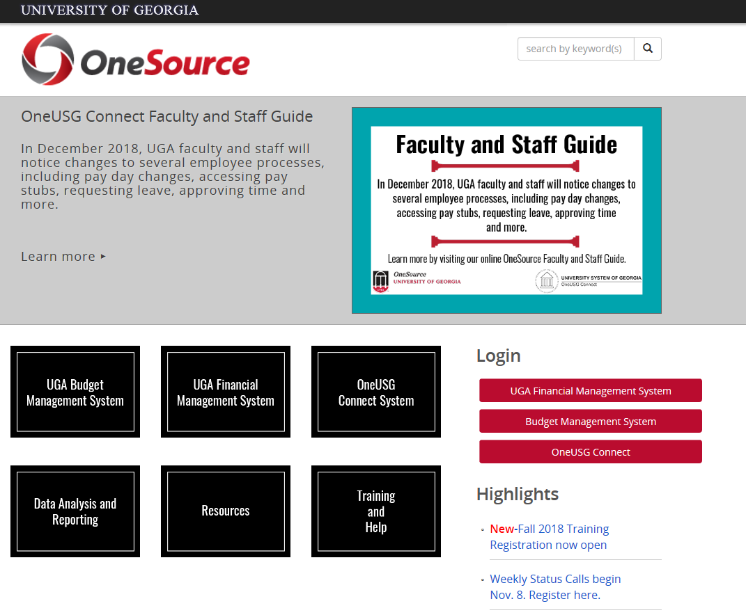
Questions/Suggestions/Concerns
Project Feedback
onesource.uga.edu
onesource@uga.edu
oneusgsupport@uga.edu

